Slide 1
ECON 672
Week 10: Synthetic Control
Samuel Rowe, PhD 2/2/2023

Slide 2
Overview
The Takeaway
Introduction and Motivating Examples
Formalization of the Estimator
Example California Prop 99
Inference
Falsification and Implementing Checklist
State Example

Slide 3
The Takeaway
Overview
The premise
A generalized difference-in-differences method that can get around the problem of having only 1 treatment group
This method uses predictive covariates to generate a synthetic control group for the treatment group by applying an optimal set of weights
We are mixing methods
We are using predictive analytics and causal inference at an aggregate level

Slide 4
The Takeaway
Overview
Pros
Does not have inference issues with only 1 treatment group like 2x2 DD
It’s visually intensive like RDD
A counterfactual for the treatment group is generated by applying an optimal set of weights from our pool of comparisons
Weights are transparent
Helps prevent ad hoc selection of comparison groups or peeking at results
Helps prevent standard errors from reflecting sample variance instead of the ability of the control group to reproduce a counterfactual to the treatment

Slide 5
The Takeaway
Overview
Cons
We are still matching on observable characteristics and we cannot match or generate weights based upon unobservable characteristics
Parallel trends assumption still needs to be satisfied
No canned inference packages and inference needs to be calculated
(Note: We can used randomized inference to calculate the inference for synthetic control)

Slide 6
The Takeaway
Overview
Assumptions
Parallel Trends assumption
The main assumption just like 2x2 DD
Convex Hull Assumption
This assumption states that $Y_{it}$ is in the convex hull or minimum set that contains $Y_{it},i≠j$
The treatment state must be similar to comparison states before treatment and if the treatment group is not comparable then the assumption fails

Slide 7
The Takeaway
Overview
Testable Assumptions
We can only indirectly test the parallel trends assumption
Similar to 2x2 DD
We can test the Convex Hull assumption
We can check to make sure that the treatment group is similar to the donor pool of comparisons

Slide 8
Introduction and Motivating Example

Slide 9
Introduction and Motivating Example
Motivating Example: Mariel Boatlift
Card (1990) assesses the question of immigration’s impact on local labor market conditions
Natural experiment was the Mariel Boatlift from Cuba to South Florida from April to October 1980
Approximately 125,000 Cubans were allowed to leave Cuba for Miami
The event caused a 7% increase in low-skilled workers into a relatively small area
Card wanted to test simple competitive labor market model to see if wages and employment fell for native-born workers in Miami

Slide 10
Introduction and Motivating Example
Motivating Example: Mariel Boatlift
Card (1990) utilizes a DD model and compared Miami to Atlanta, Los Angelos, Houston, and Tampa
Using the Current Population Survey (CPS), Card found no impact on native-born workers wages or employment
Similar to the controversial Minimum Wage study, this study violated conventional wisdom
Peri and Yasenov (2018) replicated this study with a synthetic control design
Similar results were found
Peri and Yasenov (2018) contribute to the literature by replicating with a synthetic control
There may have been ad hoc selection of control cities by Card (1990)
There may have been biased standard errors with using DD with only 1 treatment group

Slide 11
Introduction and Motivating Example
Introduction of Synthetic Control
Synthetic Control
Comparative Case Study
Uses a quantitative comparative case study by focusing on a particular single unit, such as a state, school, county, group, etc.
Optimal Set of Weights and Counterfactual
Optimizes a set of weights from a donor pool of comparison states to generate a counterfactual for the treatment state
Simple yet powerful
This is just a generalization of the difference-in-difference design and one of the most important evaluation designs in recent years (Athey and Imben, 2017)

Slide 12
Introduction and Motivating Example
Introduction of Synthetic Control
Restating the premise of synthetic control
Abadie and Gardeazabal (2003) use a method of a weighted average of units from a donor pool to model a counterfactual (synthetic control)
They argue when there a few aggregate units, this method does a better job of reproducing characteristics of a treated unit then using a single comparison unit
Especially when working with states, we want to use a combination of states and weight them together

Slide 13
Introduction and Motivating Example
Introduction of Synthetic Control
Restating strengths of synthetic control
Abadie, Diamond, and Hainmueller (2010) argue that this method has advantages over regression-based methods
The counterfactual is interpolated instead extrapolated - similarities are based on data
The construction of the counterfactual does not require access to post-treatment outcomes (or helps avoid peeking while specifying)
Weights are constructed transparently
Bridges qualitative and quantitative studies

Slide 14
Introduction and Motivating Example
Introduction of Synthetic Control
Preventing Ad Hoc Selection
Abadie, Diamond, and Hainmueller (2010) argue that this helps prevent ad hoc selection of comparison groups
The weights are optimized because the minimize the distance between the treatment and control group and prevent ad hoc selection
Research endogenously choosing still a problem
Ferman, Pinto, and Possebom (2020) note that the distance function is still endogenously chosen by the researchers
Ferman, et al. (2020) recommend specification tests for robustness to prevent cherry picking results

Slide 15
Formalization of the Estimator

Slide 16
Formalization of the Estimator
Formalization
The Estimator
$$\overset{̂}{δ}=Y_{1t}-\overset{J+1}{\underset{j=2}{∑}}w_{j}^{*}Y_{jt}$$
Where $w_{j}^{*}$ is a vector of optimized weights that is a function of our choice of covariates
Let $Y_{jt}$ be the outcome of interest for unit $j$ of $J+1$ aggregate units at time $t$
$J=1$ will be our treatment group and $J+1$ will be our donor pool of comparisons
The synthetic control estimator estimates the effect of the program at time $t≥T_{0}$
It’s just the difference between our treatment group and a weighted control group at time $T_{0}$ where our optimized-weighted control group will depend on our set of covariates we choose

Slide 17
Formalization of the Estimator
Formalization
Matching variables
Matching variables $X_{1}$ and $X_{0}$ are chosen as predictors of post-intervention outcomes and must be unaffected by the program, treatment, or intervention
Weights
Weights are chosen to minimize the norm (or distance) between observations subject to some constraints
$$∥X_{1}-X_{0}W∥$$

Slide 18
Formalization of the Estimator
Formalization
Weight constraints
There are 2 weight constraints
$W=(w_{2},...,w_{J+1})^{′}$ and $w_{j}≥0$, for $j=2,...,J+1$
$$w_{2}+...w_{J+1}=1$$
In other words
There are no negative weights (but zero weights are okay)
The weights must sum to 1

Slide 19
Formalization of the Estimator
Formalization
Minimizing distance (or optimizing weights)
Minimizing the distance between treatment and our control requires $∥X_{1}-X_{0}W∥=\sqrt{(X_{1}-X_{0}W)^{′}V(X_{1}-X_{0})}$
We can see that the covariates of our control group are weighted by $W$ and the distance is minimized between treatment and control covariates by our choice of $V$
$W$ is a function of $V$, so choice of $V$ matters

Slide 20
Formalization of the Estimator
Formalization
What is $V$ and why does it matter?
$V$ determines the importance of each covariate (weight of each covariate)
$V$ is a $(k×k)$ positive semidefinite matrix that contains the diagonal, $v_{1},...,v_{k}$
We have $k$ number of covariates that is indexed by $m$
Synthetic control weights minimize
$$\overset{k}{\underset{m=1}{∑}}v_{m}(X_{1m}-\overset{J+1}{\underset{j=2}{∑}}w_{j}X_{j}m)^{2}$$

Slide 21
Formalization of the Estimator
Formalization
Choice of $V$
Optimal weights, $W^{*}$, are dependent upon our choice of $V$
Synthetic Control $W^{*}(V)$ is meant to reproduce the treatment group in absence of treatment
Covariate importance weights, $v_{1},...,v_{k}$, should reflect the predictive power of the covariates

Slide 22
Formalization of the Estimator
Formalization
Choice for $V$
Abadie, Diamond, and Hainmueller suggest choosing $V$ that minimizes the mean squared prediction error in the pre-treatment period
$$\overset{T_{0}}{\underset{t=1}{∑}}(Y_{1t}-\overset{J+1}{\underset{j=2}{∑}}w_{j}^{*}(V)Y_{jt})^{2}$$
It is a good idea to do specification tests on your choice of $V$, as well

Slide 23
Formalization of the Estimator
Formalization
What about unobserved factors?
Abadie, et al. (2010) argue that is you have sufficiently large number of pre-treatment periods
Matching on pre-treatment outcomes can help control for heterogenous responses to multiple unobserved factors
We’ll see this in the example, where pre-treatment smoking rates is a covariate of interest
The intuition is that only groups that are alike on observed and unobserved factors will follow a similar path

Slide 24
Formalization of the Estimator
Takeaway
Synthetic control is just the difference between our treatment group and an optimized-weighted control group at time $T_{0}$
Weights are dependent on our choice of covariates and the importance of each covariate is set by $V$
Our optimized weights, $W$, are a function of the predictive power of the covariates and their importance weights $V$
Most people choose a $V$ that minimizes the mean squared prediction error
Use pre-treatment outcomes with sufficient time periods to alleviate unobservables

Slide 25
Example
California Prop 99
Abadie, Diamond, and Hainmueller (2010) want to assess the impact of California Prop 99 on smoking
In 1988, California passed Proposition 99, which increased taxes on cigarettes by $0.25 per pack, spurred a clean-air ordinance, funded anti-smoking media campaign, etc.
The law produced more than $100 million in anti-tobacco projects
It is important to note that other states followed California’s lead and these states were dropped from the analysis (AK, HI, MD, MI, NJ, NY, WA)

Slide 26
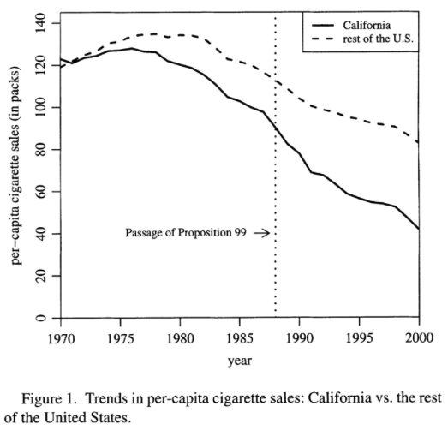
Example
California Prop 99
From the plotting the raw data there is a general declining trend in sales of cigarettes pack per capita
We cannot distinguish if there is a causal effect by plotting the raw data
California seems to decline at a faster rate than the rest of the U.S.
We need a synthetic comparison to assess the causal effect

Slide 27
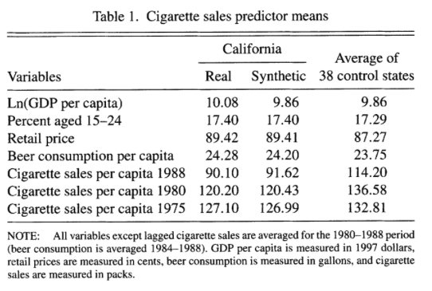
Example
California Prop 99
The authors provide the covariates used to generate Synthetic California
The authors provide a covariate balance test
lagged pre-treatment outcomes
logged GDP per capita
% of 15-24 year olds
Retail Price
Beer consumption per capita

Slide 28
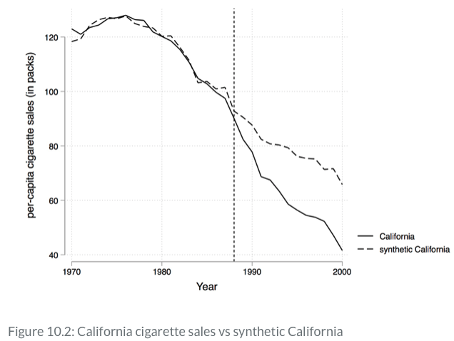
Example
California Prop 99
Comparing California to synthetic California from1970 to 2000
Parallel trends before treatment
Synthetic California is based on weighted outcomes from 38 donor states
Note: The authors choice of covariates impacts the weights
There appears to be an impact of Prop 99 on per capita sales at $T_{0}$

Slide 29
Example
California Prop 99
Similar to RDD, synthetic control design if very visually intensive
There appears to be an impact especially after $T_{0}$

Slide 30
Inference
Synthetic Control

Slide 31
Inference
Synthetic Control
Estimator
We have seen the steps for the estimator
How do we calculate the inference?
Exact p-values
Abadie, Diamond, and Hainmueller (2010) suggest using exact p-values based on Fisher (1935)
If we want to know if California’s Prop 99 had a statistically significant impact, so we will compare it to a distribution of placebo tests from the pool of donors

Slide 32
Inference
Synthetic Control
Setting up Exact p-values
We need to set up a null hypothesis of “no treatment effect”
Using randomized inference, we assign treatment to every untreated unit
We recalculate the model’s key coefficients
We collect the key coefficients in a distribution and use the distribution for inference
Abadie, et al (2010) suggest using root mean squared prediction error (RMSPE) values in pre-treatment and post-treatment as the statistic used for inference

Slide 33
Inference
Synthetic Control
We have six steps for calculating exact p-values
1)Iteratively apply the synthetic control method to each group unit in the donor pool and obtain a distribution of placebo effects
2) Calculate the RMSPE for each placebo in pre-treatment
$$RMSPE_{pre}=(\frac{1}{T_{0}}\overset{T_{0}}{\underset{t=1}{∑}}(Y_{1t}-\overset{J+1}{\underset{j=2}{∑}}w_{j}^{*}Y_{jt}))^{\frac{1}{2}}$$
3) Calculate the RMSPE for each placebo in post-treatment (post-treatment period)
$$RMSPE_{pre}=(\frac{1}{T-T_{0}}\overset{T}{\underset{t=T_{0}+t}{∑}}(Y_{1t}-\overset{J+1}{\underset{j=2}{∑}}w_{j}^{*}Y_{jt}))^{\frac{1}{2}}$$

Slide 34
Inference
Synthetic Control
We have six steps for calculating exact p-values
4) Compute the ratio of post-treatment to pre-treatment RMSPE for each group
$$\frac{RMSPE_{Post}}{RMSPE_{Pre}}$$
5) Sort the ratios in the descending order from greatest to highest and rank
6) Calculate the treatment unit’s ratio in the distribution
$$p=\frac{Rank}{Total}$$

Slide 35
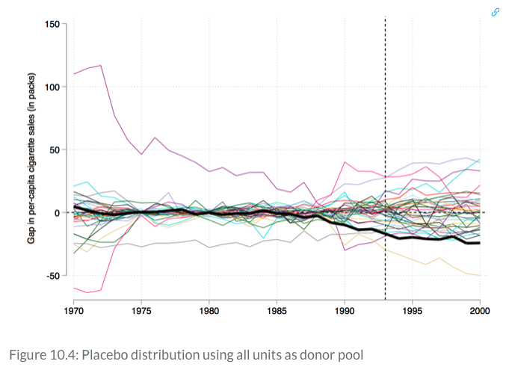
Inference
Synthetic Control
Implementing exact p-values
Plotting
We can overall all placebos with Stata two-way
California is in the tail end of the distribution after $T_{0}$
We can also see states that are radically different in pre-treatment period

Slide 36
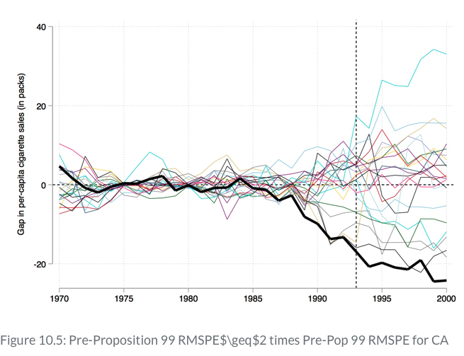
Inference
Synthetic Control
Iteratively, we can drop states that are radically different from California in the pre-treatment period
Abadie, et al. (2010) suggest dropping any pre-treatment that is greater than 2 times your treatment state

Slide 37
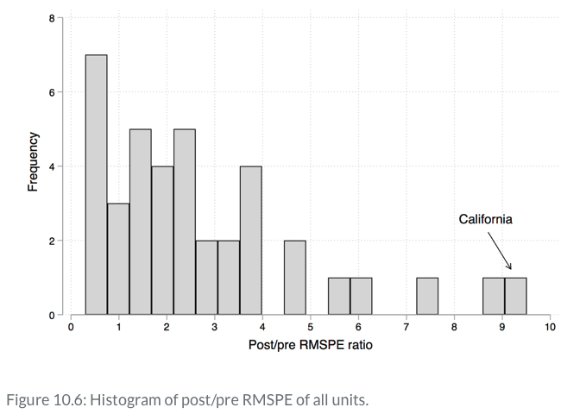
Inference
Synthetic Control
Using inference based on exact p-values, we can also plot the histogram of p-value ratios
California ranks 1st out of the 38 states units
(where other states with similar legislation where dropped)
California had an exact p-value of 0.026

Slide 38
Falsification and Implementing Checklist

Slide 39
Falsification
Placebo Date
Testing the Validity
We can test the validity of the synthetic control estimator through falsification (or placebo tests)
False $T_{0}$
We can set a placebo date or $T_{0Fake}$ to a date earlier than the adoption date
Placebo $T_{0Fake}$ should have no impact on the outcome

Slide 40
Implementing Synthetic Control
Checklist
Check the quality of pre-treatment fit
Minimize the Mean Squared Error (MSE)
Check for covariate balance
Show a covariate balance table for treatment, synthetic control, and donor pool
Specification Tests
You need to use specification tests for your selection of V
Report a few specifications to prevent cherry picking
Falsification Tests
Using False Dates or False Groups (but we use false groups for our inference)

Slide 41
Stata Example
Prison Construction and Black Male Incarceration
Cunningham examines the impact of Texas’ prison construction on Black male incarceration
Background
In 1980, the Texas Department of Corrections lost a lawsuit in Ruiz v Estelle, where Ruiz was the prisoner and Estelle was the warden
The case argued that overcrowding and other prison conditions were unconstitutional
To assure compliance, the Texas Department of Corrections was placed under court supervision until 2003

Slide 42
Stata Example
Prison Construction and Black Male Incarceration
Background (cont)
Texas had a choice after Ruiz v Estelle if it wanted to continue arrests at the same rate
Build more prisons or parole more prisoners - initially Texas chose more paroles
In 1993, Governor Anne Richards began allocating state funding to build more prisons and the state legislature approved $1 billion for prison construction
This increased capacity after 1993
Texas began to shift away from paroles and towards keep prisoners in prison

Slide 43
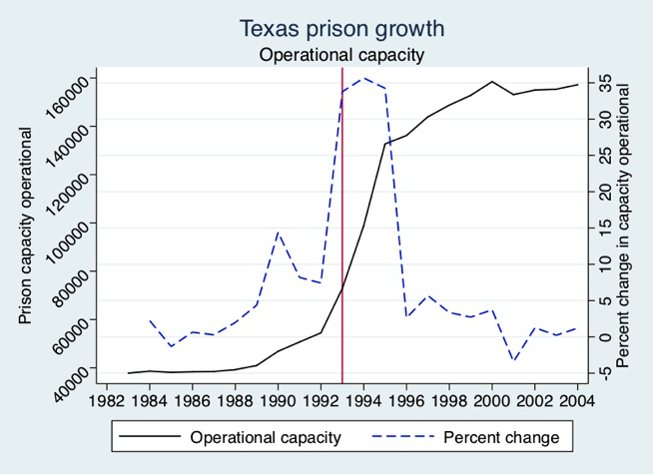
Stata Example
Prison Construction and Black Male Incarceration
We can see the impact of the governor and legislature investment in operational capacity $T_{0}=1993$
But, did this increase in prison capacity have an impact elsewhere?

Slide 44
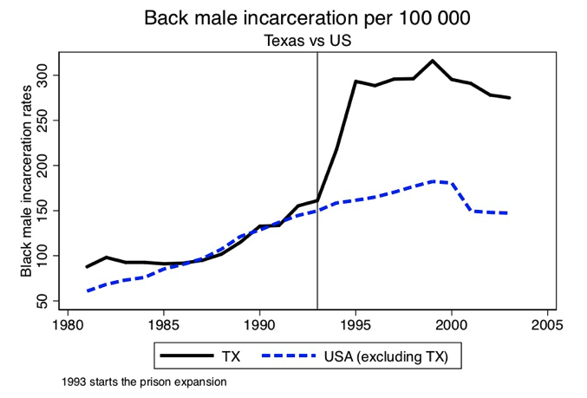
Stata Example
Prison Construction and Black Male Incarceration
Looking at Black male incarceration, we can see that there was an increase in Texas starting in 1993 compared to the rest of the United States
Both Texas and the rest of the U.S. had increase trends in Black male incarceration before 1993

Slide 45
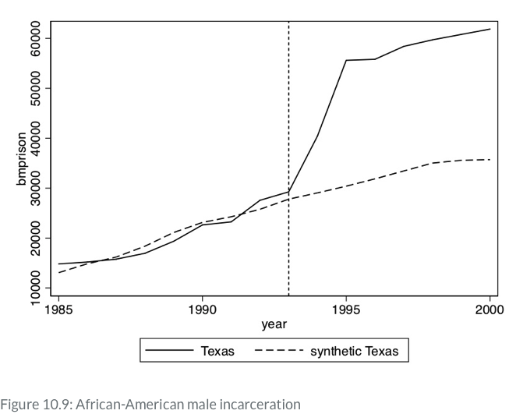
Stata Example
Prison Construction and Black Male Incarceration
Cunningham provides the covariates used to estimate synthetic Texas
Lagged pre-treatment rates in 1988, 1990, 1991, and 1992
Unemployment rate, income, and poverty
Lagged AIDS per capita in 1990, 1991
Lagged Black population % in 1990, 1991, and 1992
Percentage of 15-24 year olds in 1990

Slide 46
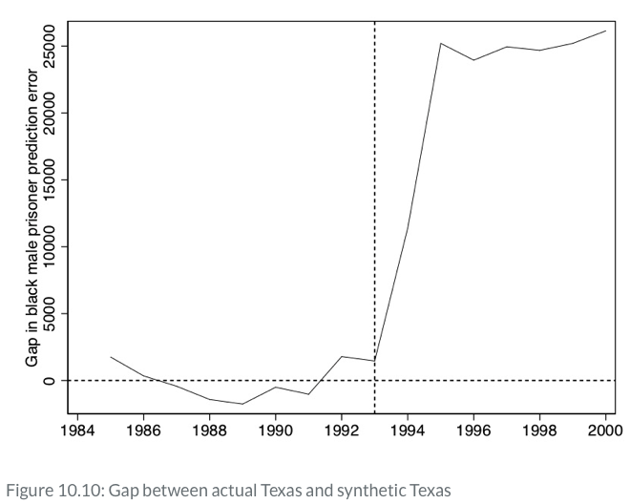
Stata Example
Prison Construction and Black Male Incarceration
Cunningham provides the gap between Texas and synthetic Texas in the Black male prisoner prediction error
It shows similar pre-treatment trends before $T_{0}$

Slide 47
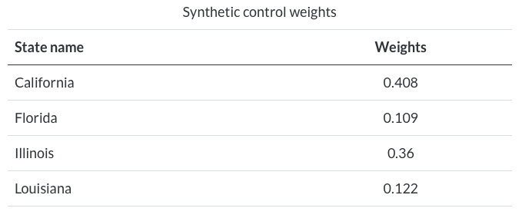
Stata Example
Prison Construction and Black Male Incarceration
Cunningham also provides the weights that are optimized from his choice of $V$
California makes up 0.408 of synthetic Texas, while Illinois makes up 0.36 of synthetic Texas
Florida and Louisiana make up the rest and all other states are 0 weighted

Slide 48
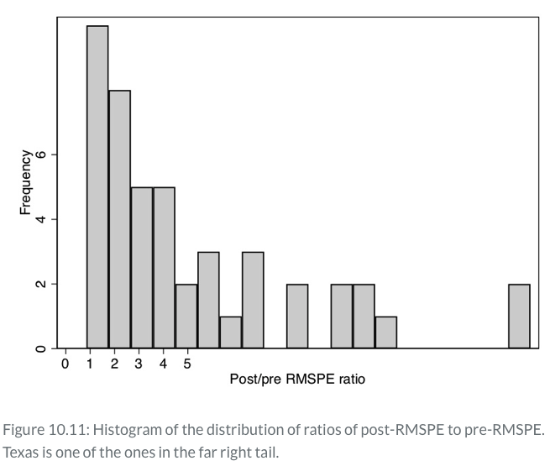
Stata Example
Prison Construction and Black Male Incarceration
Cunningham next provides the steps for calculating exact p-values
Texas has the 2nd highest ratio out of 46 state units
The exact p-value was $p=0.04$

Slide 49
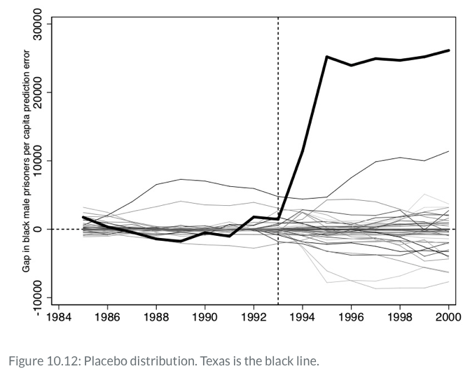
Stata Example
Prison Construction and Black Male Incarceration
Cunningham finally provides the distribution of placebo tests for all 46 placebo tests
Texas can be seen on the top, which shows a trend that is different from other donor states
If you wanted a falsification, you could use prior years such as 1988 or 1989 and end the sample in 1992

